Slide 1
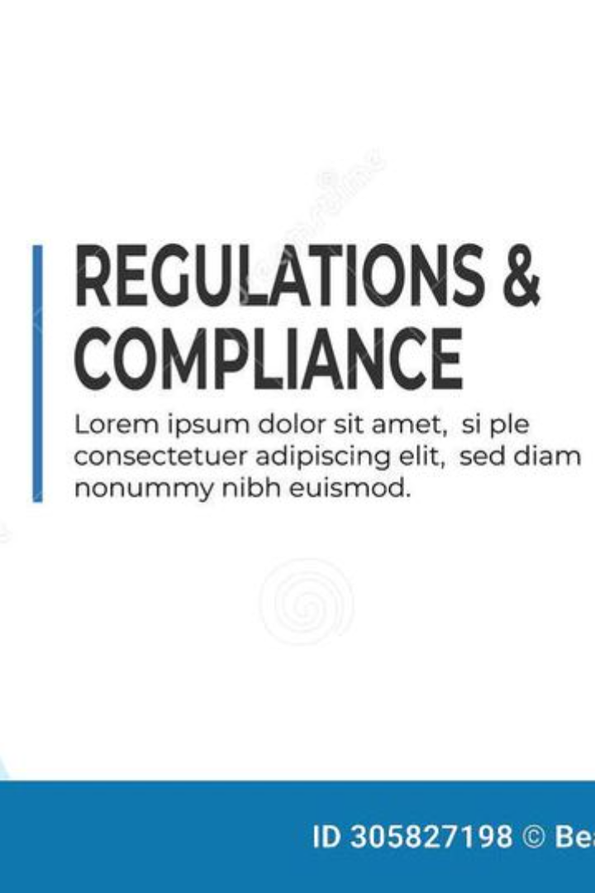
Introduction to Compliance Assessment
This compliance assessment aims to ensure that the catalog strictly adheres to labeling regulations and is in line with industry standards. It's crucial to conduct a meticulous examination to guarantee that all products within the catalog comply with legal requirements, providing customers with accurate, transparent, and reliable information.
RG

Slide 2

Purpose of the Test Case
1
Adherence to Regulations
The purpose of this test case is to meticulously examine the catalog's adherence to labeling regulations. It ensures that all products are labeled accurately and transparently, meeting industry standards and legal requirements.

Slide 3

Importance of Ensuring a Thorough Evaluation
1
Consumer Trust
Thorough evaluations build consumer trust by ensuring that the catalog provides accurate information about the products, enhancing the reputation of the brand.
2
Legal Compliance
Thorough evaluations ensure legal compliance, reducing the risk of fines, penalties, and legal disputes related to inaccurate product information.
3
Market Reputation
Thorough evaluations contribute to a positive market reputation, demonstrating the brand's commitment to quality and transparency.

Slide 4
Key Regulations and Standards to be Assessed
FDA Regulations
Industry Standards
The assessment will focus on adherence to the labeling regulations set by the Food and Drug Administration (FDA).
It will also evaluate compliance with industry-specific labeling standards to ensure consistency and accuracy.

Slide 5
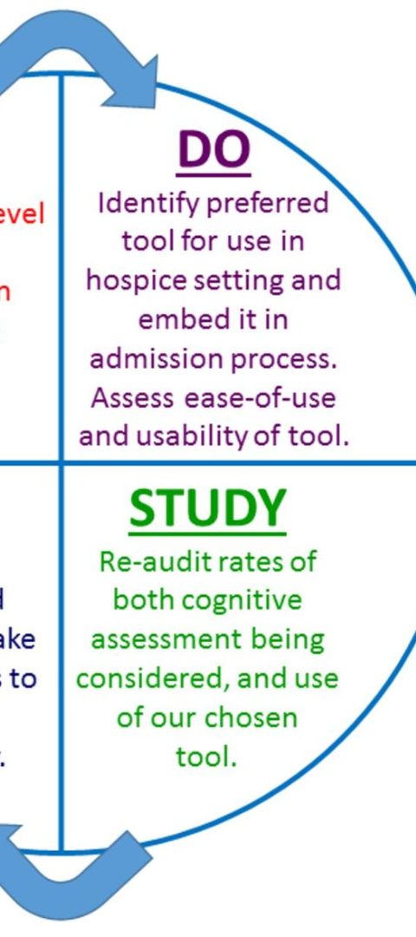



Methodology for Conducting the Assessment
Research
Collect relevant information about labeling regulations and standards.
Design Assessment Criteria
Develop detailed criteria for evaluating product labeling and adherence to regulations.
Field Evaluations
Conduct on-site assessments to validate the accuracy of product labeling and compliance.

Slide 6
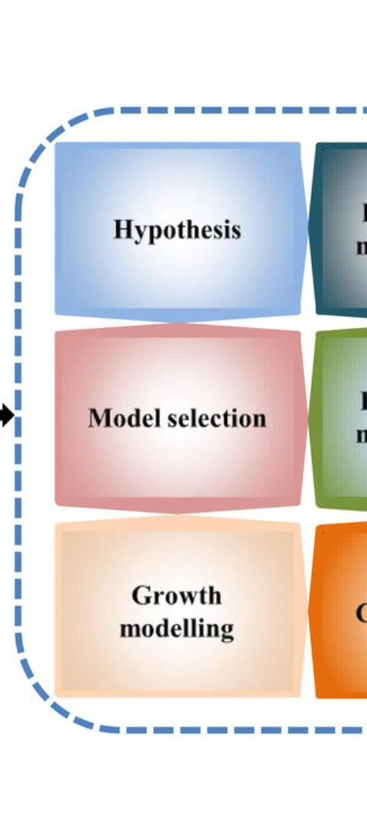
Data Collection and Analysis Process
Data Gathering
Collect product labeling data from various sources within the catalog.
Accuracy Verification
Verify the accuracy of the collected data against regulatory requirements and industry standards.
Analytical Review
Analyze the data to identify areas of non-compliance and develop insights for improvement.

Slide 7
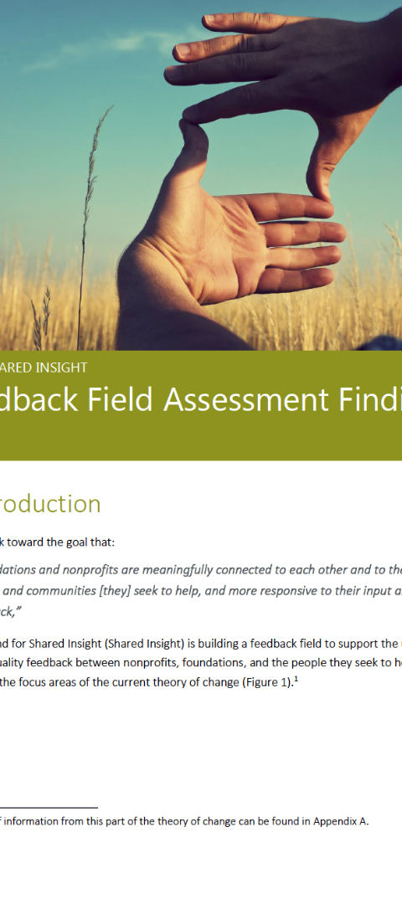
Findings and Observations from the Assessment
1
Compliance Metrics
2
Non-Compliance Incidents
Provide detailed metrics on the level of compliance, highlighting areas of strength and improvement.
Highlight specific incidents of non-compliance along with the associated risks and impact.

Slide 8
Recommendations for Improving Compliance
Process Enhancements
Training Initiatives
Recommend process improvements to strengthen labeling compliance measures and ensure ongoing accuracy.
Suggest training programs for employees to enhance awareness and understanding of labeling regulations.

